Slide 1
https://codeburst.io/algorithms-i-searching-and-sorting-algorithms-56497dbaef20

Slide 2
CSS143 Computer Programming (II)

Slide 3
Lecturer
Dr. Peng Du
High performance computing
Matrix stuff
Cloud computing
Virtual machine

Slide 4
Class Info
Syllabus
https://github.com/pdgetrf/CSS143B
Canvas
Only used for homework and grading
Discord
Invite: https://discord.gg/JMgeenh
Class Survey
https://tinyurl.com/prog-w20-pre (do it today)

Slide 5
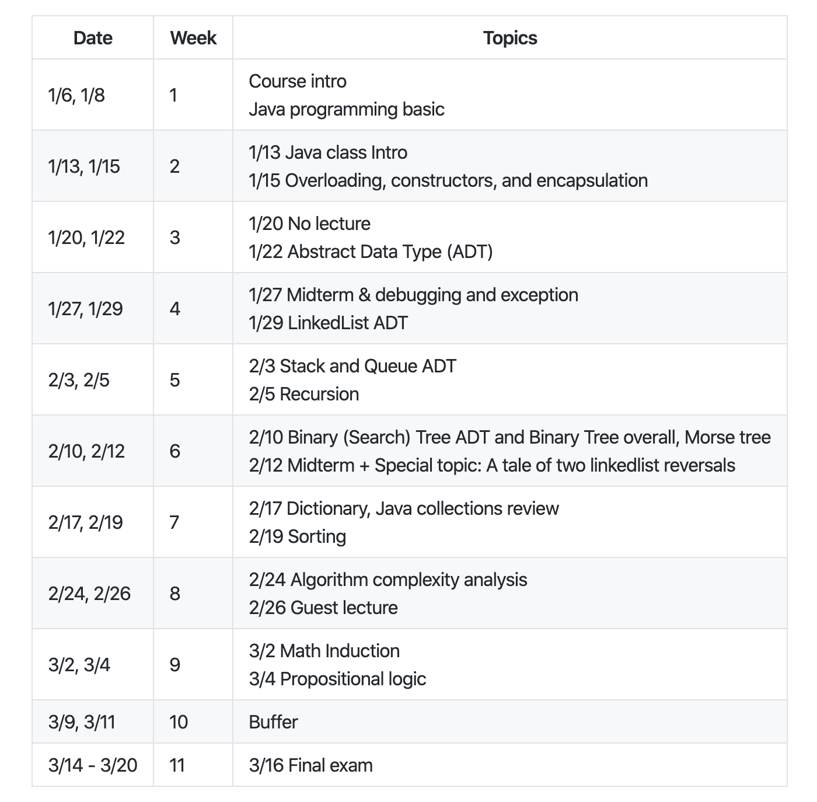
Class Info
Most recent version here: https://github.com/pdgetrf/CSS143B

Slide 6
Lecture Styling
Slides
Demo Code from lecture!
15-min Quiz each week, closed book, coding on paper
Two midterms and one final
Hands on (lots of coding)

Slide 7
What this class is
Problem Solving Using
Computer Programming

Slide 8
What this class is
Problem Solving Using
Computer Programming
NOT programming languages

Slide 9
Computing Programming vs Programming Language
“Programming Language”
Loop
Class
Branching
Variables
Reference Passing
File I/O

Slide 10
Computing Programming vs Programming Language
“Computer Programming”
Data Structure
How to store data
Array, List, Tree, etc
Algorithm
Steps to do things
Recursion, Sorting, Searching

Slide 11
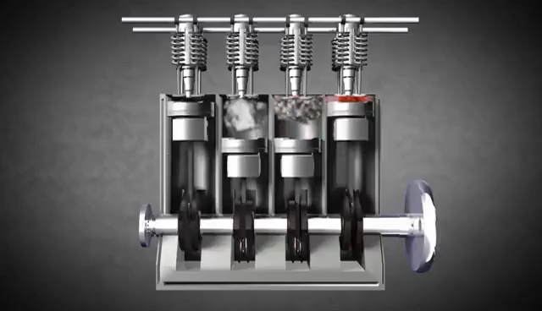
Computer Programming
Data Structure
3
0
1
2
3
4
1
5
0
1
2
3
4
0
2
4
6
Algorithm
Recursion
Searching
Sorting

Slide 12
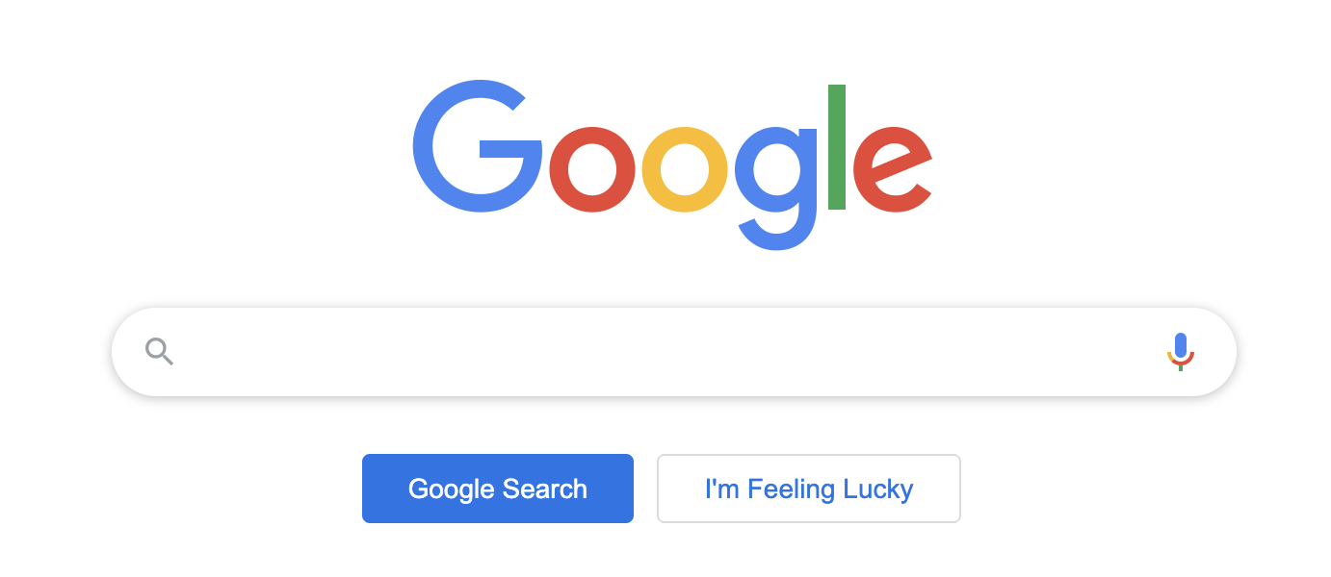
Problem Solving 1
Searching

Slide 13
A Search Problem (random array)
Target: 14
18
12
1
7
5
10
3
12
9
14
14
0
1
2
3
4
5
6
7
8
9
O(N)
N = 10 comparisons
Worst case

Slide 14
A Search Problem (sorted array)
Target: 14
Binary search
1
3
5
7
9
10
12
12
14
14
18
O(log₂N)
log₂10 = 3.322 comparions
worst case scenario

Slide 15
A Search Problem
First Sort
Then Search
O(N log₂N)
10 * log₂10 = 33.22 comparisons
O(log₂N)
log₂10 = 3.32 comparisons
But…Linear search is O(N)
10 comparisons

Slide 16
A Search Problem
data is automatically sorted when it’s generated
13
1
1
3
3
5
5
7
7
9
9
10
10
12
12
12
12
14
13
18
14
18
When there’s data, insert it into the sorted place
When search, use binary search
O(log₂N) with shuffling
O(log₂N) with shuffling
O(log₂N)

Slide 17
A search problem
How data is stored?
Sorted vs Random
Contiguous or Linked
What are the steps (“Algorithms”)
Linear Search
Binary Search

Slide 18
Problem Solving 2
Sorting

Slide 19
Let’s try this sorting thing
Everyone pick out a paper and write down a random number between 0 to 19

Slide 20
A Sorting Problem
Given a set of random number, how to sort it?
Descending Order
1
3
How many comparison?

Slide 21
A Sorting Problem
Given a set of random number, how to sort it?
Descending Order
1
3
5
1

Slide 22
A Sorting Problem
Given a set of random number, how to sort it?
Descending Order
3
5
1
How many comparison?

Slide 23
A Sorting Problem
Given a set of random number, how to sort it?
Descending Order
1
5
7
8
5
7
8
1
7
8
5
1
8
7
5
1
How many comparison?

Slide 24
A Sorting Problem
Given a set of random number, how to sort it?
Descending Order
x₁
x₂
x₃
……
x_{n}
How many comparison?

Slide 25
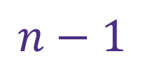


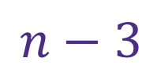
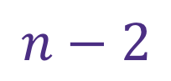
A Sorting Problem
Given a set of random number, how to sort it?
x₁
x₂
x₃
……
x$N$
$$n−1$$
1st round:
$$n−2$$
2nd round:
$$n−3$$
3rd round:
……
……
N^{th} round:
$$1$$

Slide 26
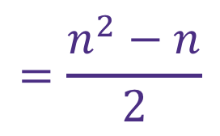
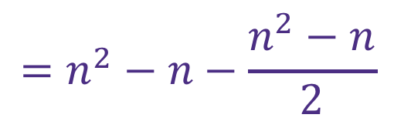
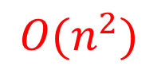
A Sorting Problem
Given a set of random number, how to sort it?
x₁
x₂
x₃
……
x$N$
$$\left(n−1\right)+\left(n−2\right)+\left(n−3\right)+…+2+1$$
$$\left(n−1\right)+\left(n−2\right)+\left(n−3\right)+…+2+1$$
$$\left(n−1\right)+\left(n−2\right)+…+(n−\left(n−2\right))+(n−\left(n−1\right))$$
$$=\left(n−1\right)×n−(1+2+3+…+\left(n−1\right))$$
$$=n^{2}−n−\frac{n^{2}−n}{2}$$
$$=\frac{n^{2}−n}{2}$$
$$O(n^{2})$$

Slide 27
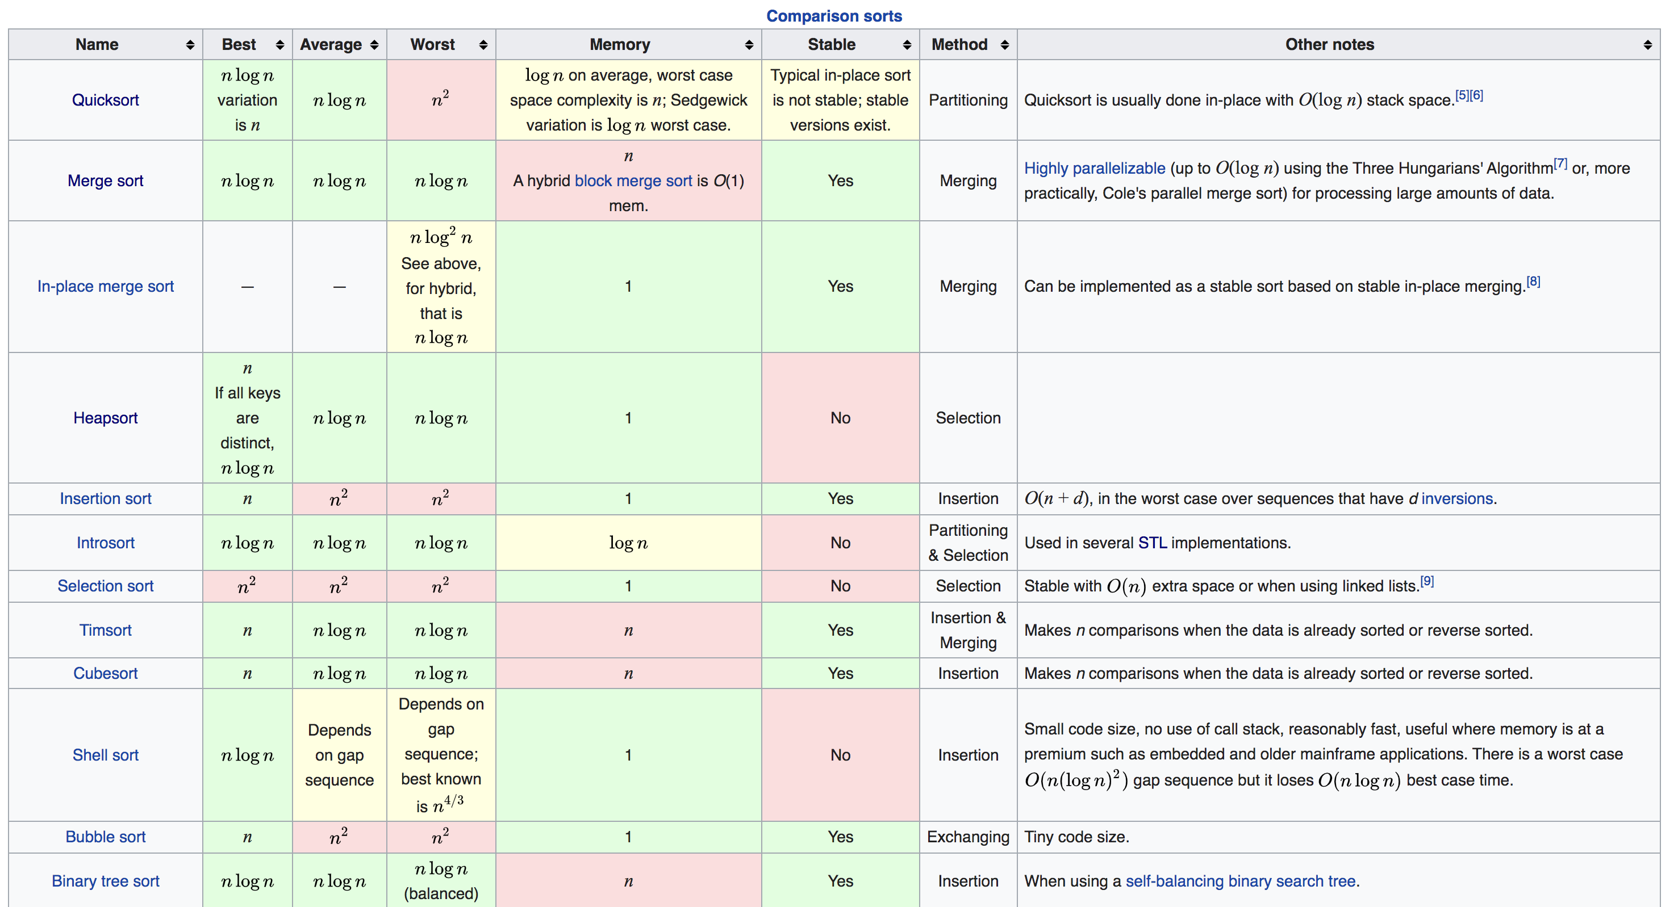
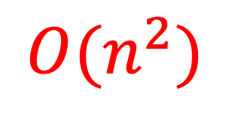
A Complexity Problem
Algorithm Complexity
$$O(n^{2})$$

Slide 28
A Complexity Problem
Algorithm Complexity
“Complexity”
Time
Space
Usually time and space can be traded off with each other
demo

Slide 29
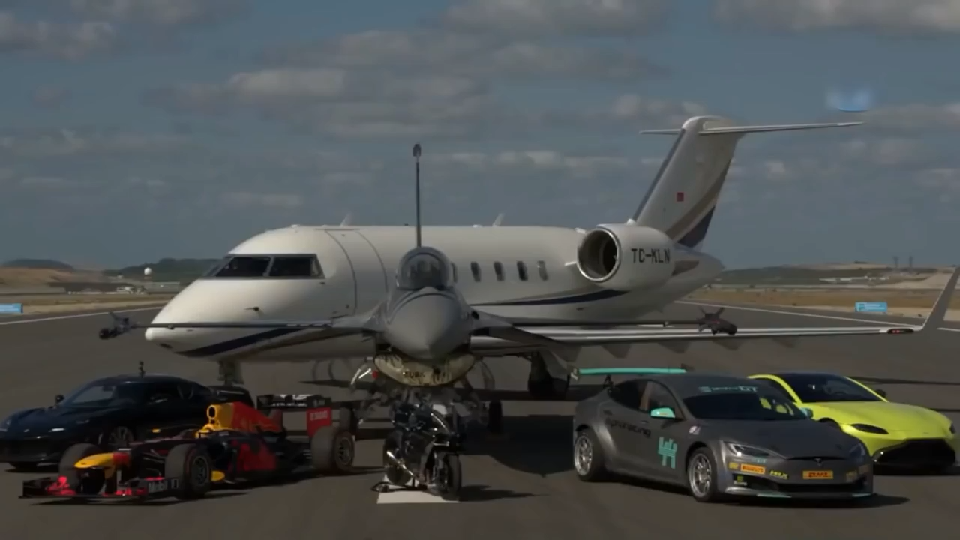
A Complexity Problem
Which one is fastest?
F1 by Redbull Racing Formula One
Motorcycle (Kawasaki Ninja H2R)
F16 Fighter Jet
Challenger 605 Private Jet
Aston Martin Vantage,
Lotus Evora GT430
Tesla Model S P100DL

Slide 30
A Complexity Problem
Which one is fastest?
Bubble Sort
Merge Sort
Binary Search
Binary Tree Lowest Common Ancester
Matrix Multiplcation

Slide 31
A Correctness Problem
“Does it work?”
“Does it work all the time?”

Slide 32
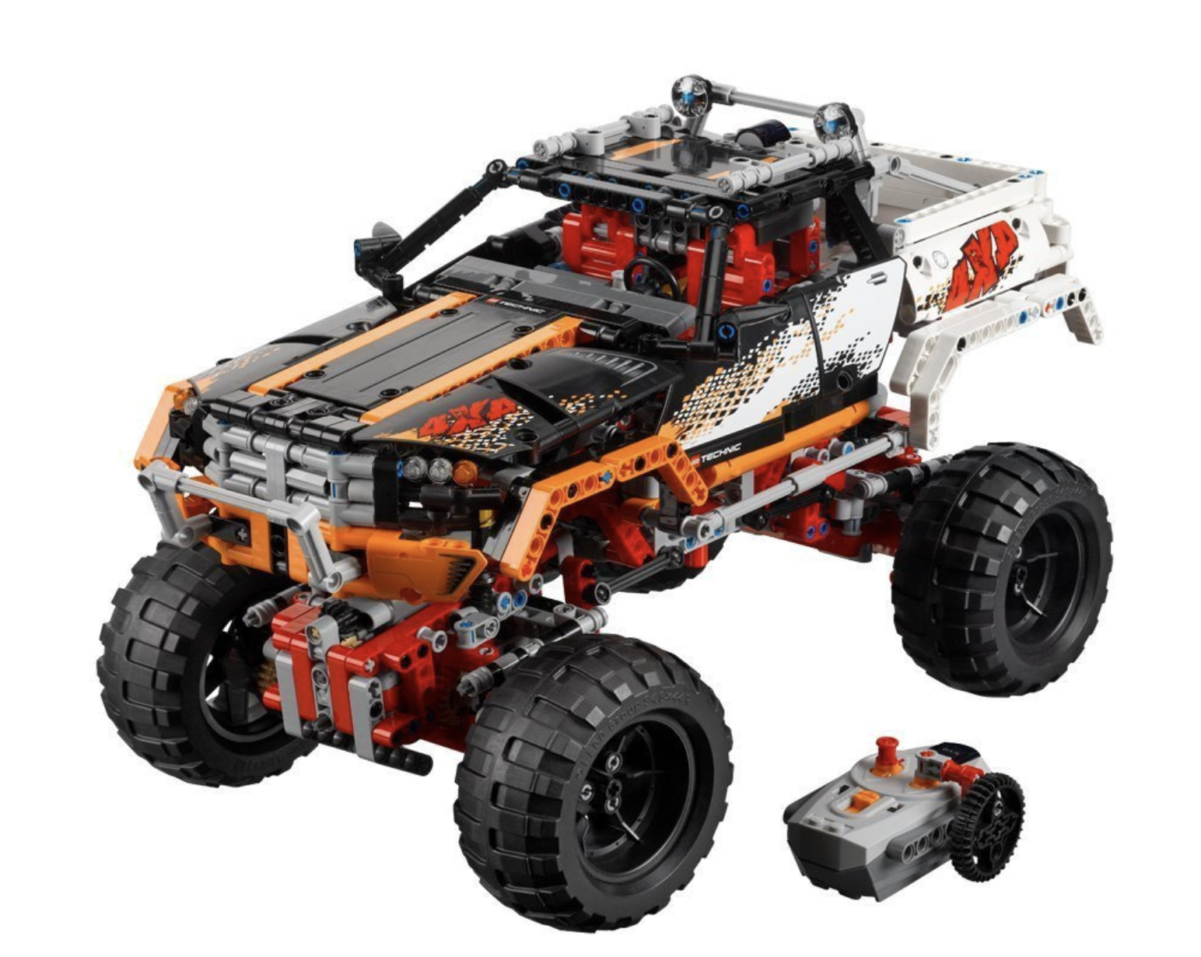
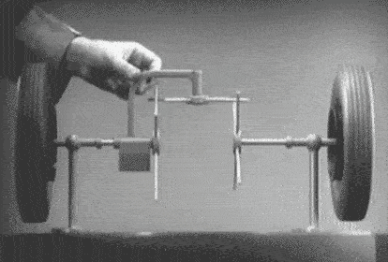
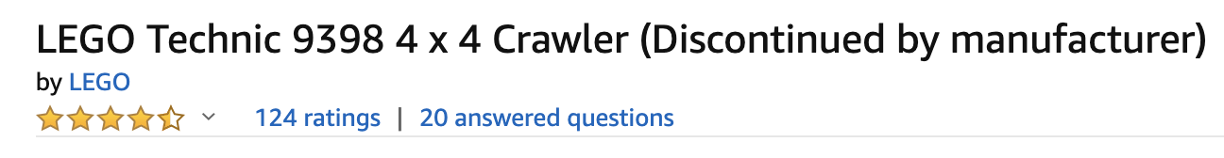
A Correctness Problem
Open Differential

Slide 33
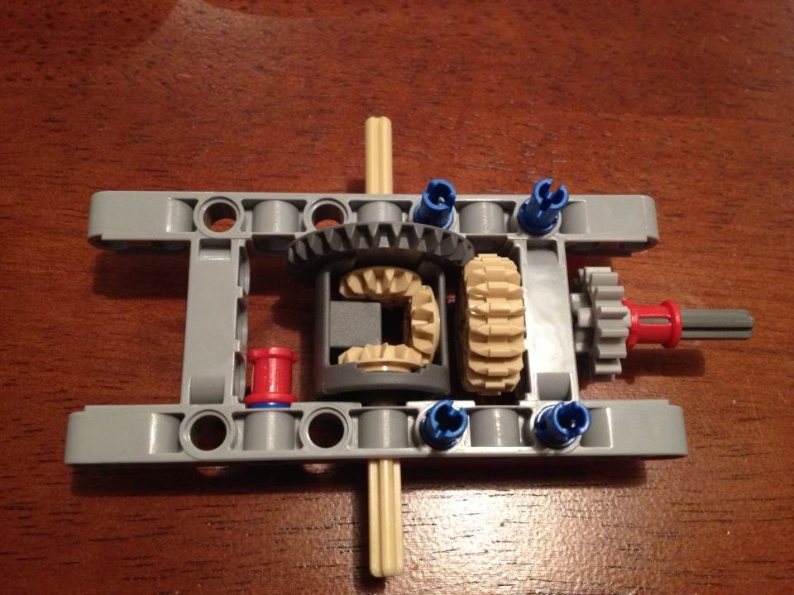
A Correctness Problem
Input:
Torque on drive shaft
Output:
Torque on wheel axles
How do you test this differential?

Slide 34
A Correctness Problem
Input:
Torque on drive shaft
Output:
Torque on wheel axles
Feature:
Axles rotate independently
How do you test this differential?

Slide 35
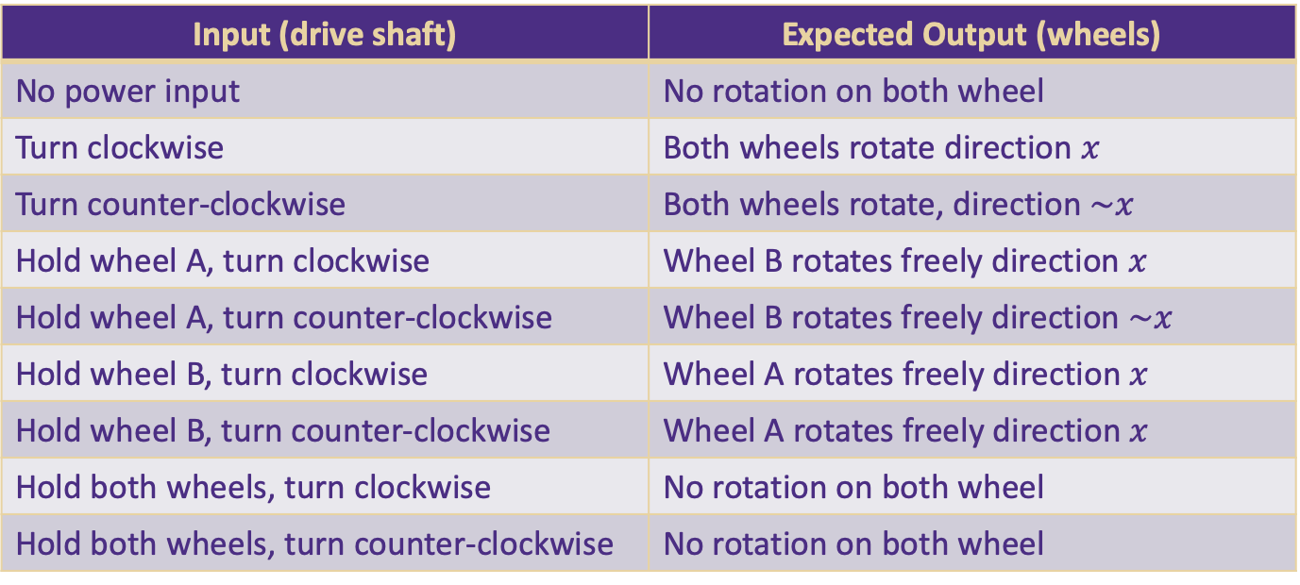
A Correctness Problem
Output: wheel A
input
Feature To Test:
Axles rotate independently
Output: wheel B
Input (drive shaft) | Expected Output (wheels)
No power input | No rotation on both wheel
Turn clockwise | Both wheels rotate direction $x$
Turn counter-clockwise | Both wheels rotate, direction $\sim x$
Hold wheel A, turn clockwise | Wheel B rotates freely direction $x$
Hold wheel A, turn counter-clockwise | Wheel B rotates freely direction $\sim x$
Hold wheel B, turn clockwise | Wheel A rotates freely direction $x$
Hold wheel B, turn counter-clockwise | Wheel A rotates freely direction $x$
Hold both wheels, turn clockwise | No rotation on both wheel
Hold both wheels, turn counter-clockwise | No rotation on both wheel

Slide 36
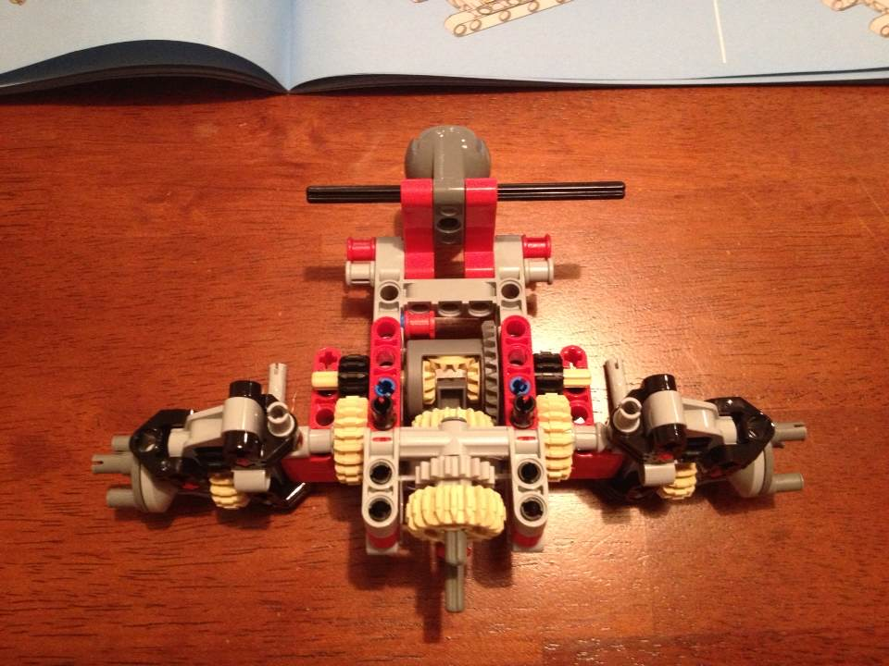
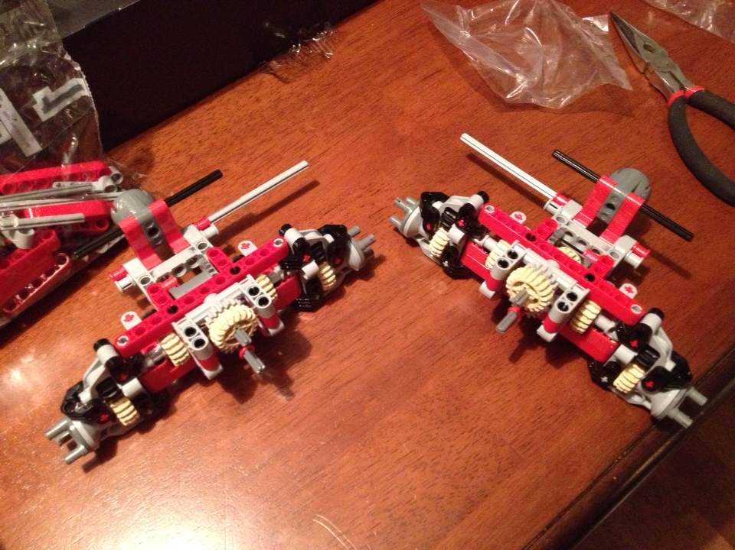
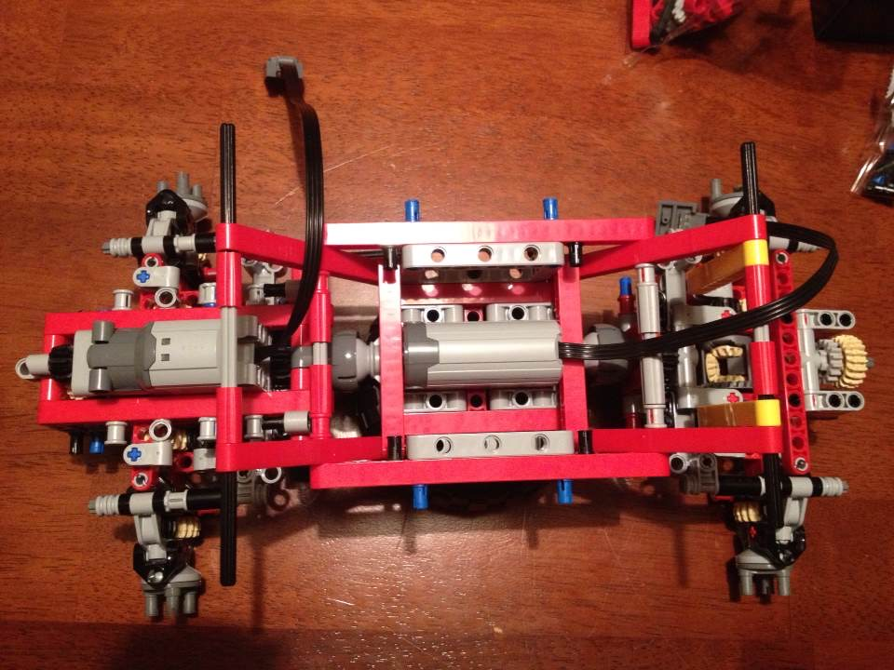
A Correctness Problem

Slide 37
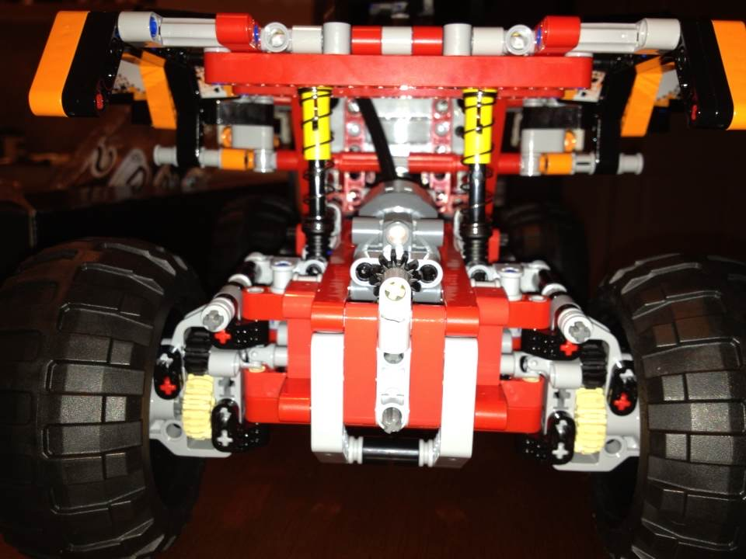
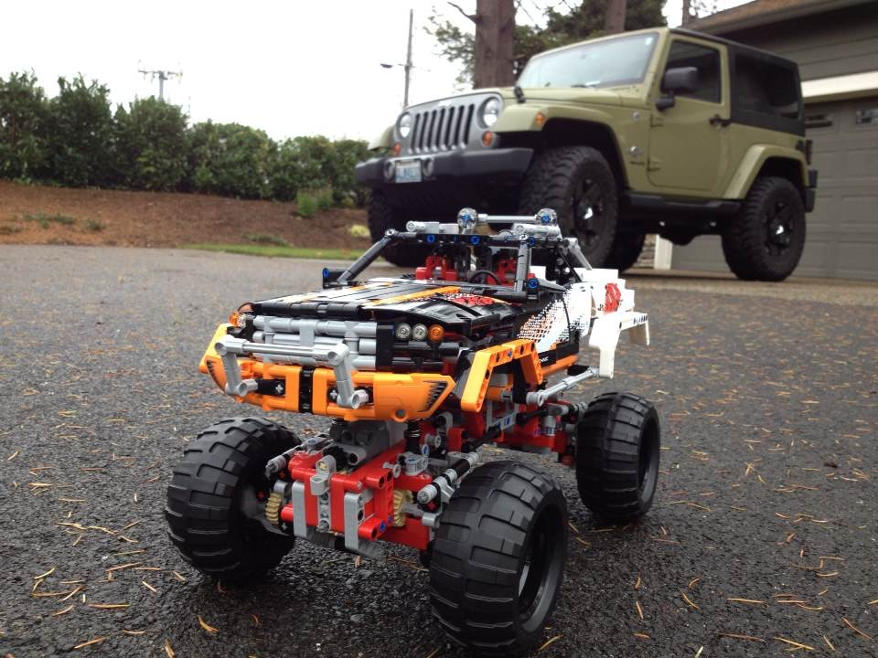
A Correctness Problem

Slide 38
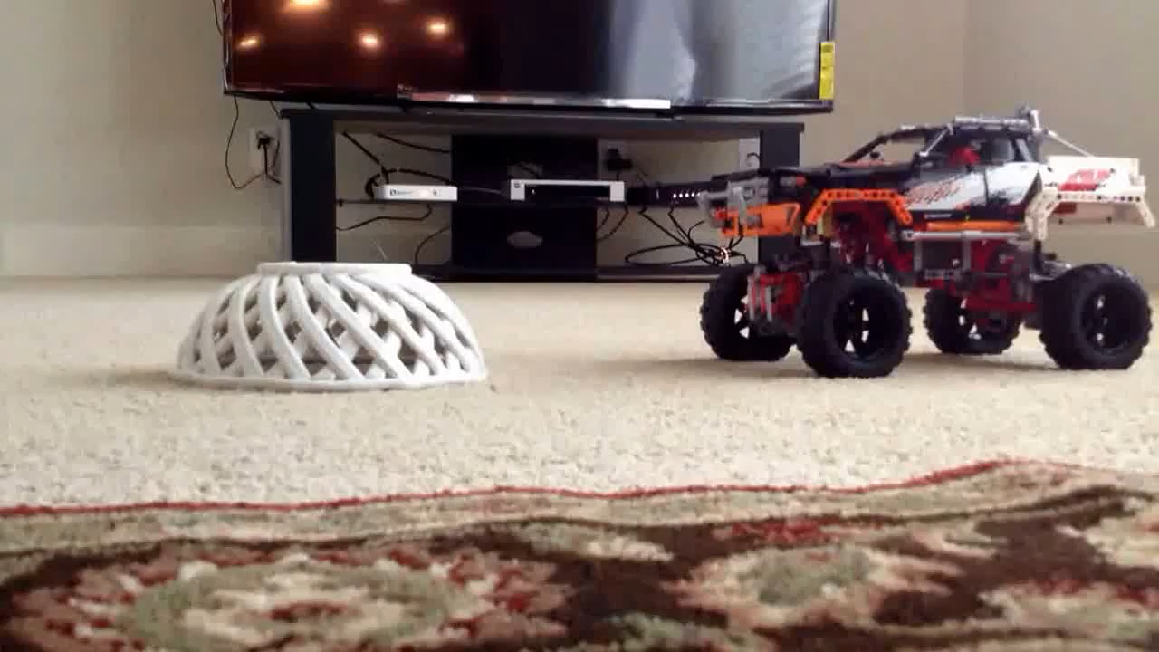
A Correctness Problem
Testing
Unit test
Integration test
Math Proof
Math Induction

Slide 39
In Summary
This class is mainly about
Computer Programming
Data Structure
How to store data
Algorithm
Steps to do things
NOT about “Programming Language”

Slide 40
Priorities
Weeks 1, 2, 3:
Set up coding environment
Can write basic Java code with good tests
Get familiar with source control (git)
Set up coding environment
Can write basic Java code with good tests
Get familiar with source control (git)

Slide 41
Priorities
Weeks 4-10:
Abstract Data Structure
Algorithms
Code Quality
Abstract Data Structure
Algorithms
Code Quality

Slide 42
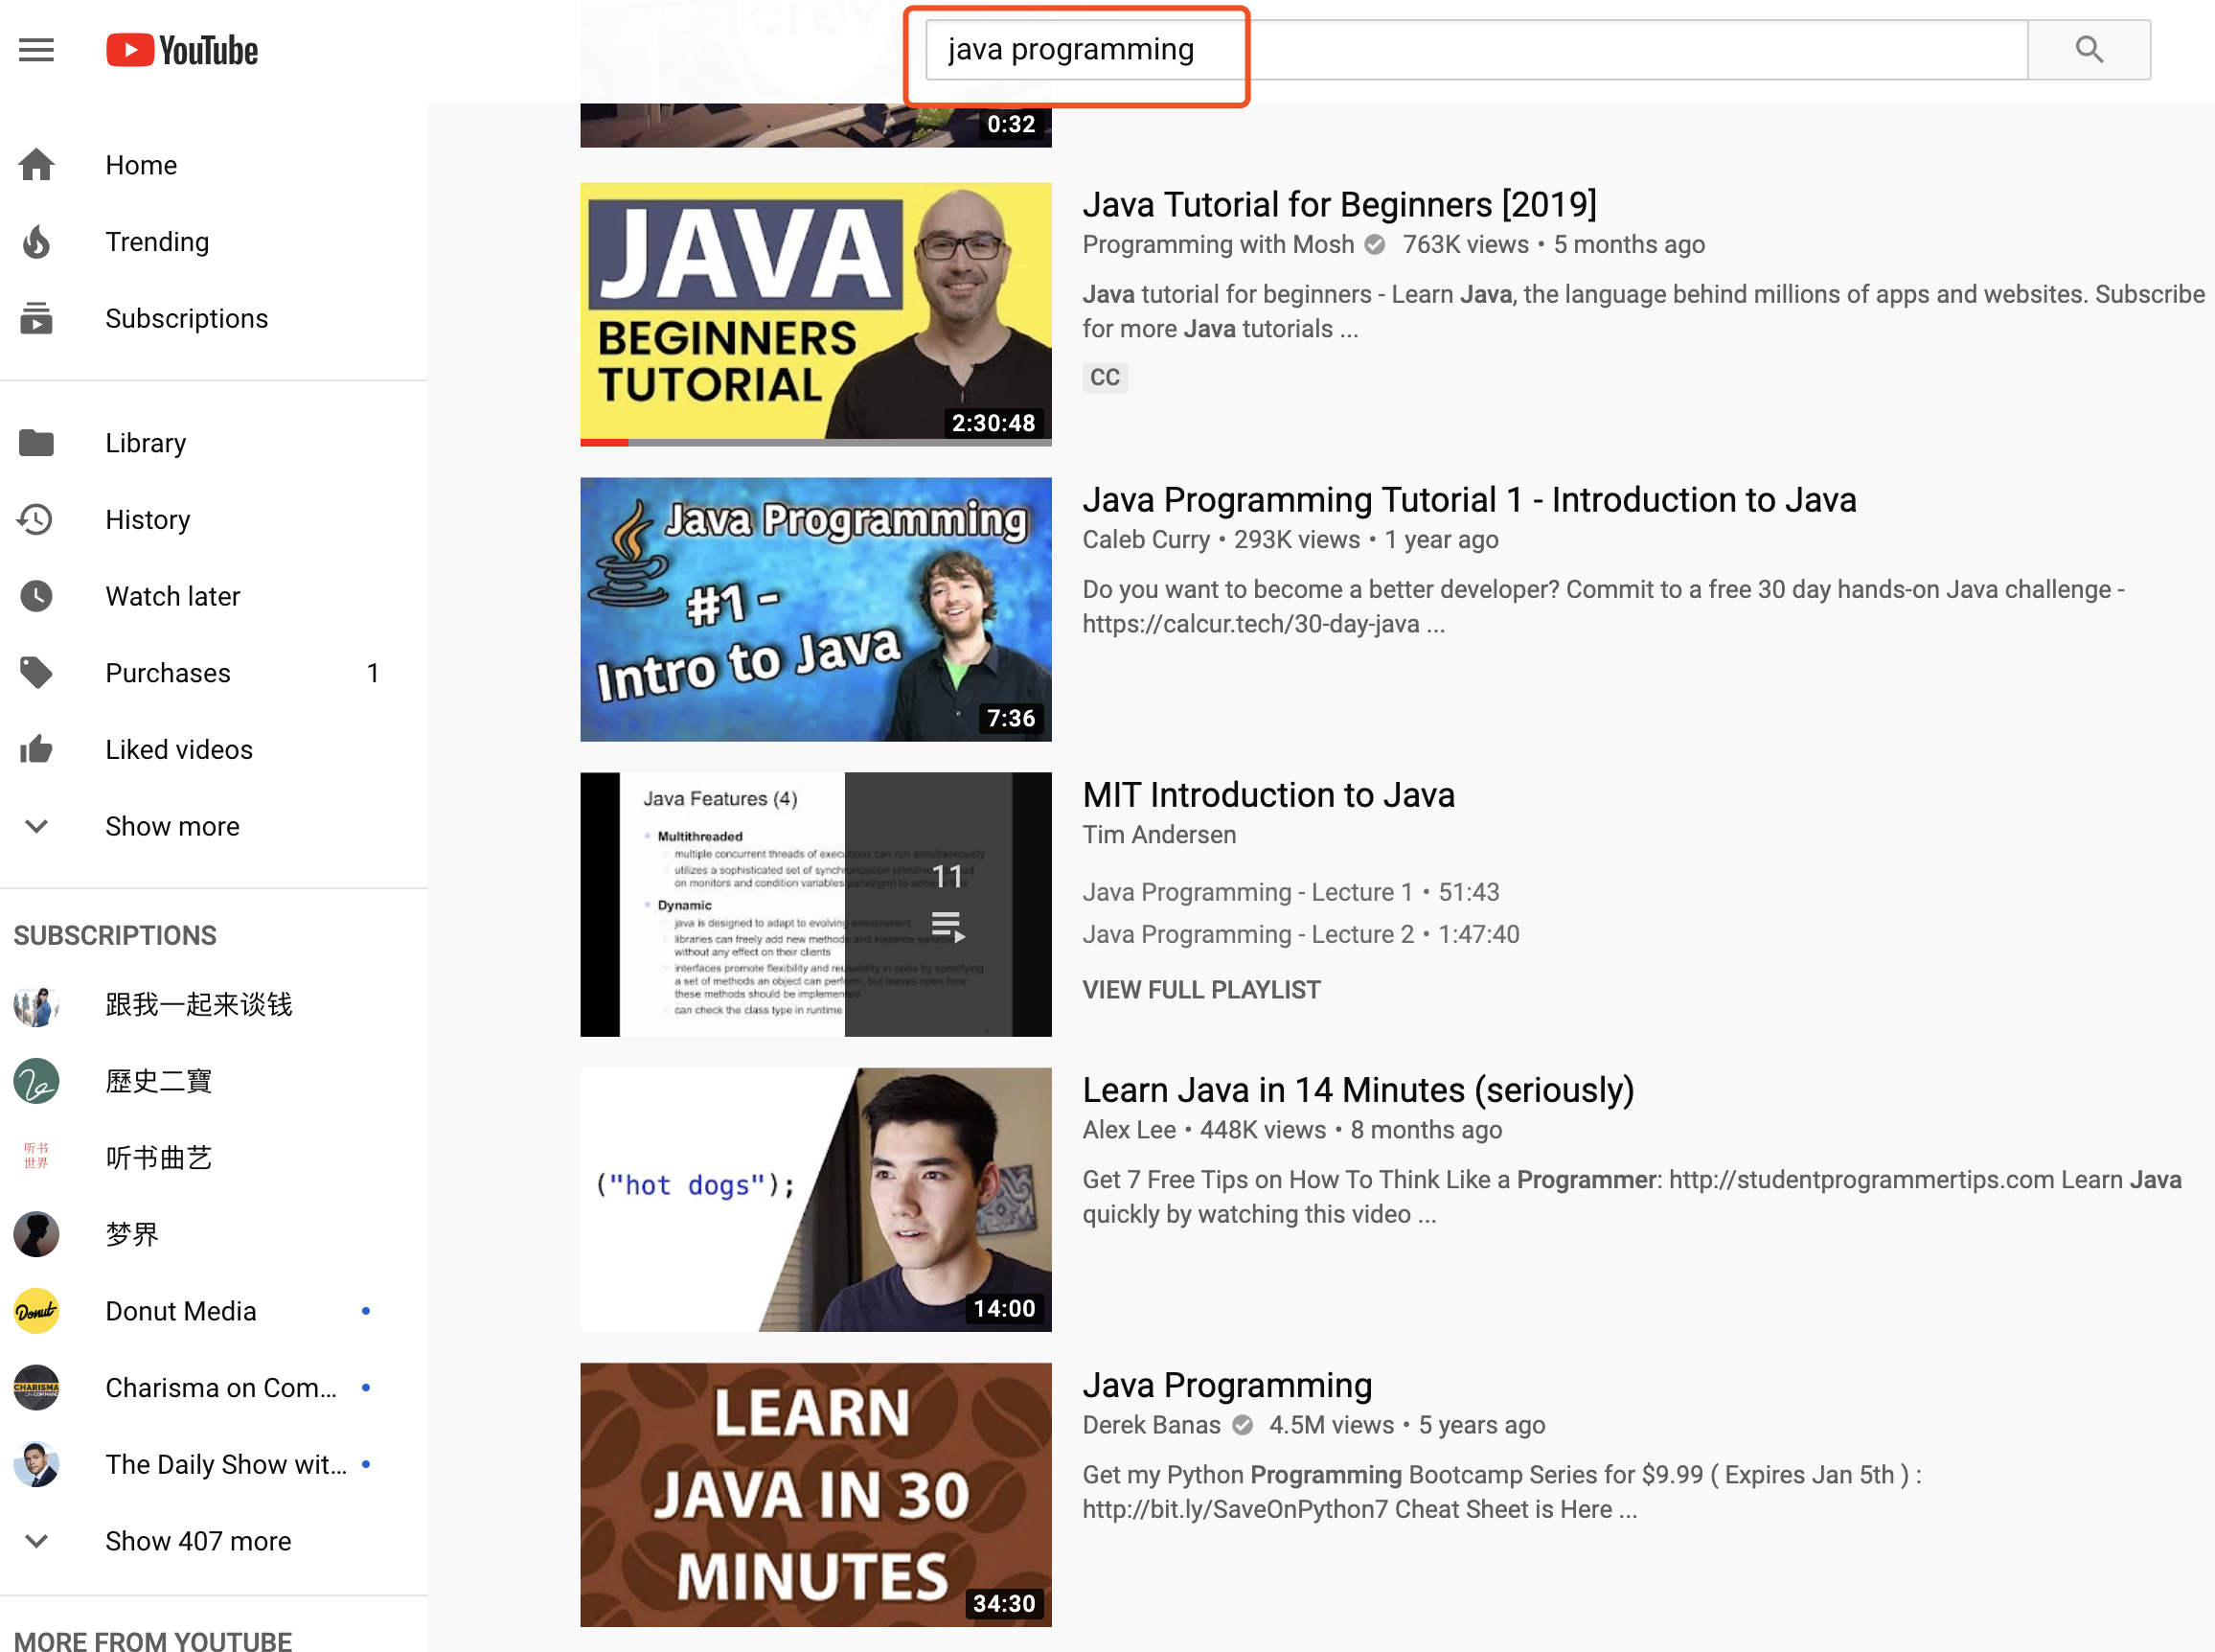
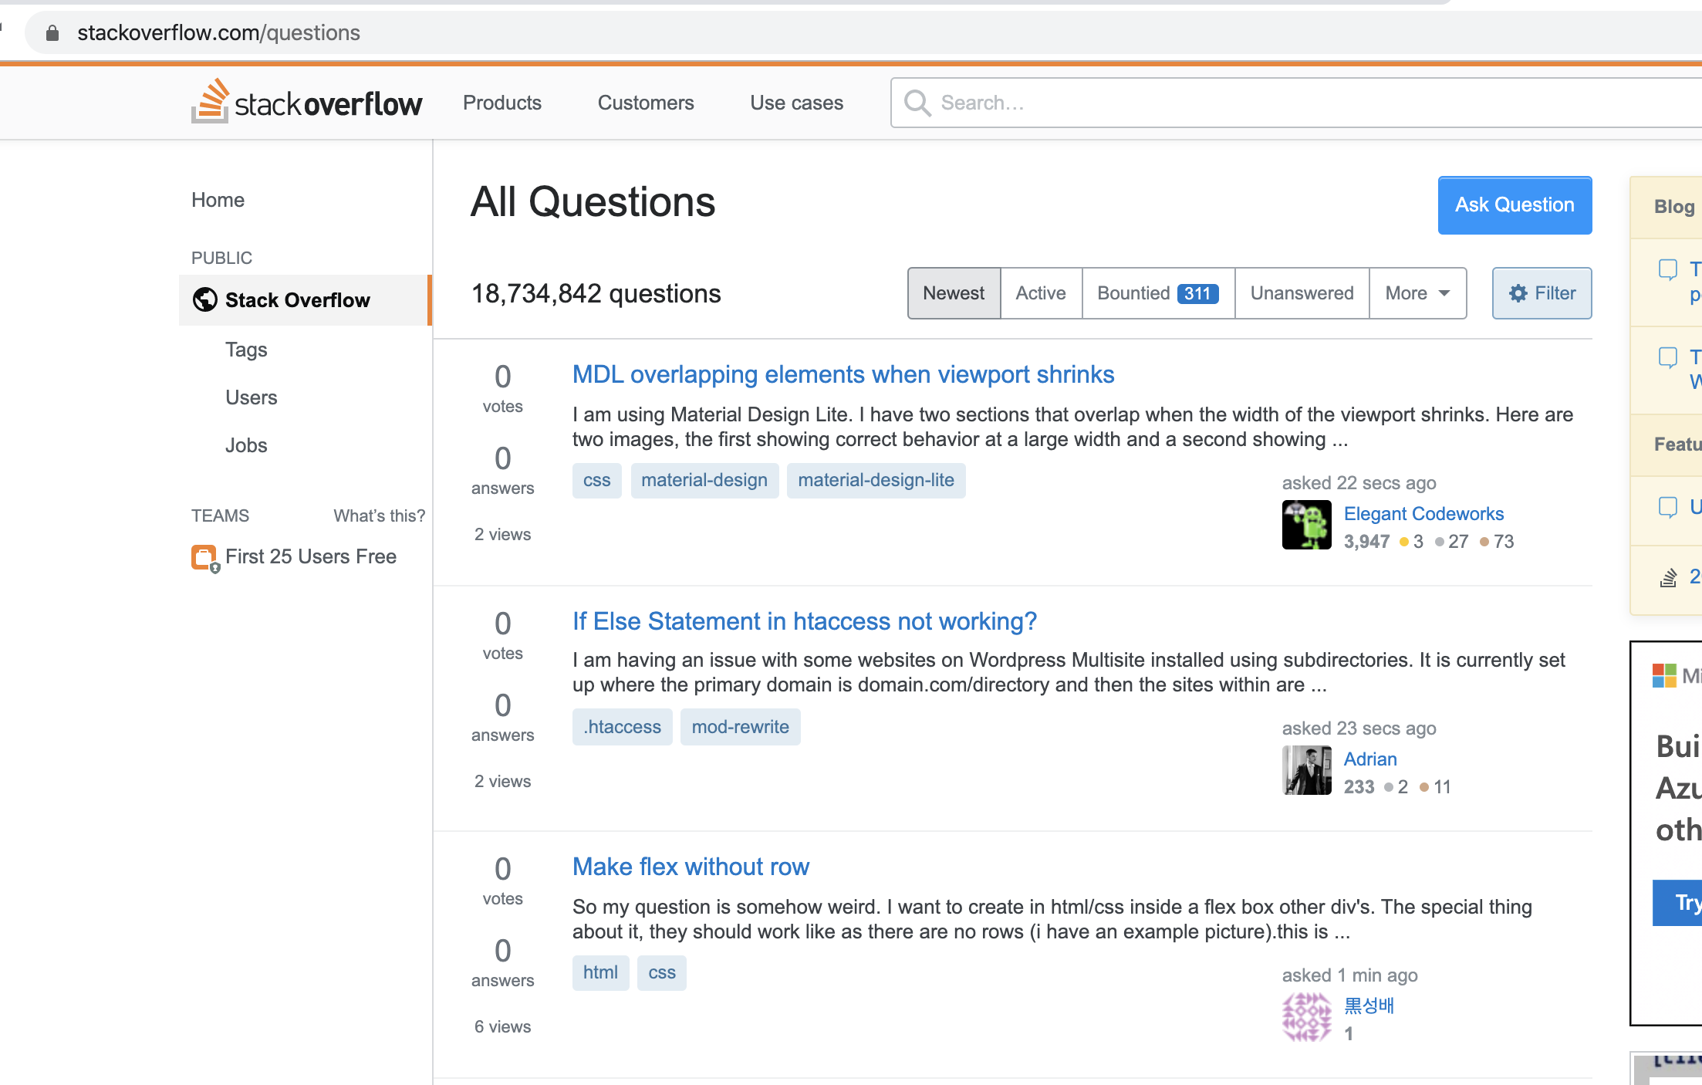

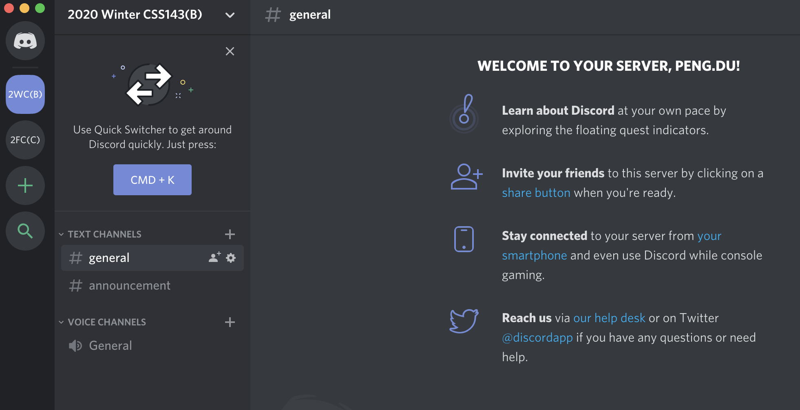
Other goals:
Learn to Learn
Be resourceful
Be an independent learner
Academically mature
Ask proper question
“My code doesn’t work!”
“My code is giving … errors! I have tried …!”

Slide 43
More on Questions
Use the discord channels
Discord Invite: https://discord.gg/JMgeenh
Study group
Saturday/Sunday
Come in person or hangout online

Slide 44
Logistics
Take notes!!
Write code on paper
Coding interview for companies is done on white board most of the time. Do not rely on debugger to find bugs.
If you miss the class, you are responsible to catch up!
No late assignment will be accepted
Exception is very very rarely given based on circumstances
No make-up exam

Slide 45
Tooling
OS:
Windows, Linux, Mac
IDE/Editor:
IntelliJ IDEA
Eclipse
VIM, Emacs
Testing:
JUnit
Source Control
Git, www.github.com

Slide 46
Tooling
OS:
Windows, Linux, Mac
IDE/Editor:
IntelliJ IDEA
Eclipse
VIM, Emacs
Testing:
JUnit
Source Control
Git, www.github.com

Slide 47
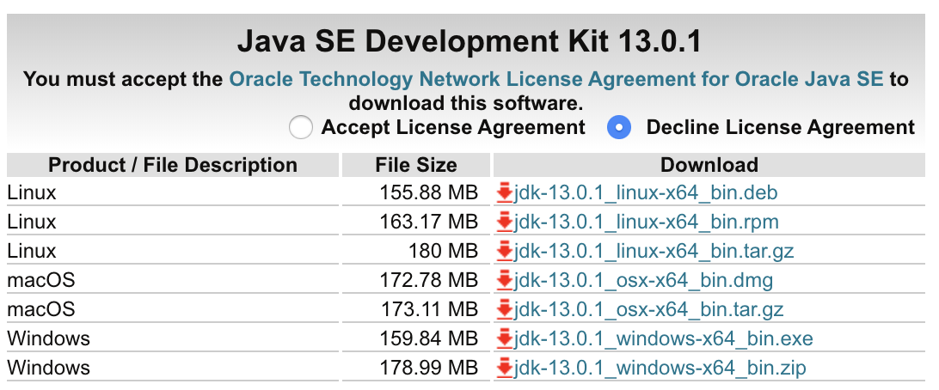
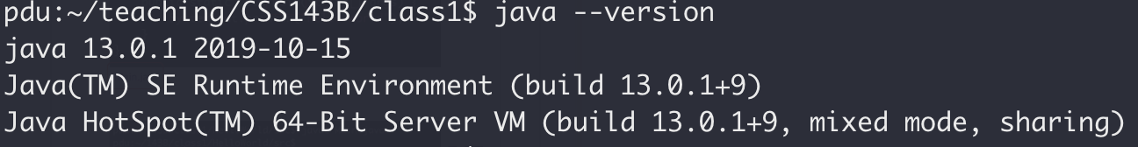
Java Development Kit
https://www.oracle.com/technetwork/java/javase/downloads/jdk13-downloads-5672538.html

Slide 48
Expectation Highlights
By the end of this course, you will:
Be comfortable with JAVA
Understand Object Oriented Programming
Be proficient with data structure like stack, queue, tree
Agree recursion is awesome but not always efficient
Have implemented your own text search engine
Not feel well writing code without git (source control)

Slide 49
Expectation
This course will/is :
NOT focusing on teaching Java, but the basics will be covered
reference, class, template, etc.
NOT A math class, but we will touch some theoretical topics such as induction as formal proof

Slide 50
Tip On Success
Prioritize!
Write Code, lots of them!
Slow in, fast out!
Communicate!
Start everything early!

Slide 51
Tip On Success
“I do not know much about Java or programming, so I will attempt to read the whole text book page by page before starting coding or homework”
“Don’t be a hero!”
Read just enough to write code,
Read more afterward

Slide 52
Tip On Success
3 days till homework due, you realized you won’t make it to the deadline because it’s more difficult than you think.
What would you do?
Panic and give up
B. Work on it quietly by yourself till last minute
C. Try to find code online and copy it and call it a day
D. Try to find code online, use it but also give it credit
D. Try to find code online, use it but also give it credit
E. Get over the social anxiety and reach out to friends/instructor for help immediately

Slide 53
Tip On Success
“Homework is due tonight midnight. I’ll work till my code is perfect and submit at 11:59pm”
No! Submit early and refine often!

Slide 54
Plagiarism
School takes this VERY VERY seriously
It’s okay to use other people’s code
Give credit
“I was using this and this for my help”
Do not copy & paste (it’s very easy to check by tools)
You may be asked to write the same code in exam
Use others’ code to learn

Slide 55
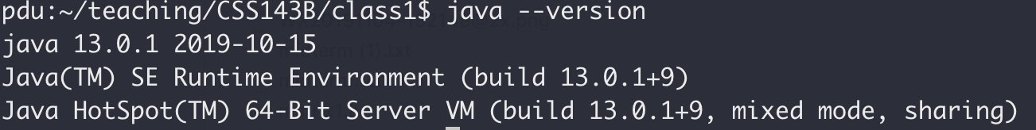
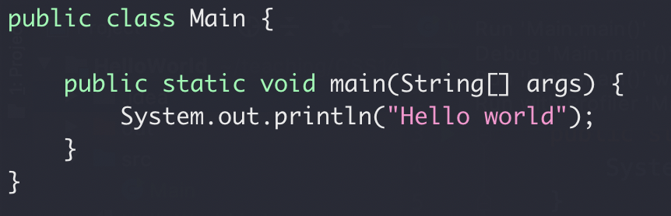
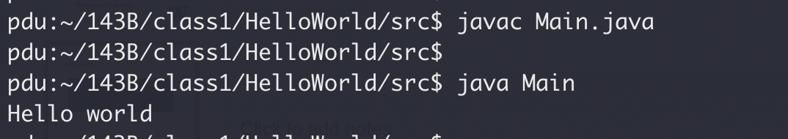
Hello World!
File name must match class name
Each program can only have one main() function
Main.java

Slide 56
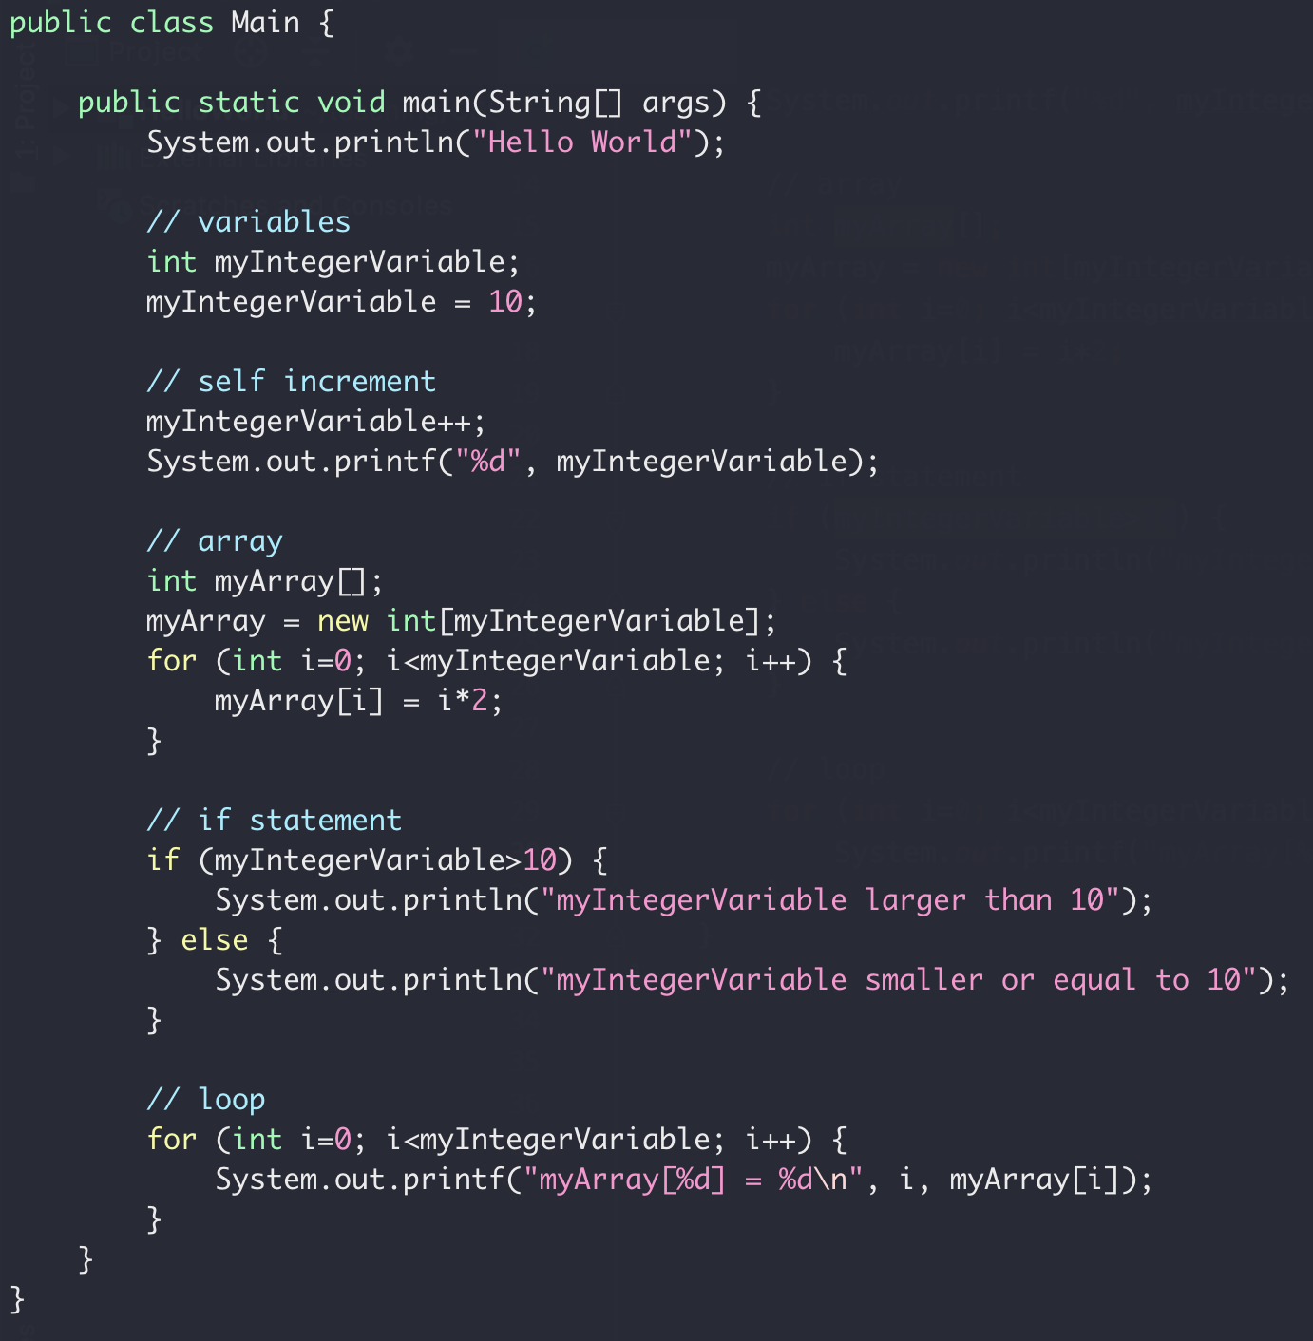
Java Basics

Slide 57
99 Bottles of Beers
"99 Bottles of Beer" is an anonymous folk song dating to the mid-20th century.
Repetitive lyrics, but some lines are missing
Let’s write a code to fill in the blank

Slide 58
99 Bottles of Beers
On a day hot enough to make the Devil cuss I walked into a bar so thirsty I was spittin' dust Barkeep asked me what'll it be? I said whatcha got? He said well let's see, we got
Lone star, PBR, Rolling Rock, Shiner Bock Moose Drool, O'Doul's, Hefeweizen, Ziegenbock, Keystone, Coors Light, 'course we got Red Stripe Amstel, Amsterdam in the tall can,
Michelob, Miller Light, Guiness by the pint glass Doppelbock Lager, take a swaller 'cause it's goin' fast Oatmeal stout and a lot of Leinenkugel's Open up your wallet, no time to be frugal there’s
99 bottles of beer on the wall 99 bottles of beer Take one down, pass it around 98 bottles of beer on the wall
Well needless to say I was pretty impressed As he handed me an ice cold beer from a chest I said, Not bad for a hole in the wall Barkeep grinned, said That ain't all, we got
Rio Grande, River Rock, Tecate with a twist top Dos Perros, Dos Equis, Foster if yer Aussie Bud Light in the new Zane Williams coozie A dozen wheat beers on tap if you're choosy, got
Heineken, Killian's, Labatt's and Beck's Ice cold na with the limes in the necks Yuengling chilling with the Old Milwaukee's best Sam Adams and that ain't even half of the rest of them
98 bottles of beer on the wall 98 bottles of beer Take one down, pass it around 97 bottles of beer on the wall

Slide 59
99 Bottles of Beers
Well I settled down with my favorite brew I ordered me another and before I knew It was 2 AM and I was under a table Bein' choked by a dude that smelled like a stable
And finally I was able to throw him through the screen door Pick up my hat off the hardwood floor Get on back to the barkeep's daughter who was Puttin' "Pop a Top" on the jukebox, dancin' non-stop
And sippin' on a beer that I bought her We were drinkin' it like it was water There were cowgirls everywhere wearin' their Pretty hair down to their derriere and there were
2 more bottles of beer on the wall 2 more bottles of beer Took one down and passed it around 1 more bottle of beer on the wall
1 more bottle of beer on the wall 1 more bottle of beer We raised it up high and drained it dry and there were
No more bottles of beer on the wall
So we started on the
Cuervo, Bacardi Gold, margaritas, straight tequila Jim Beam, George Dickel, then we wet our whistle with a
single malt scotch, peach schnapps in a jello shot Captain Morgan, pour some more of them Cider Sliders, Flyin' Tigers Dr Pepper for the designated drivers Everclear, Absolut and Amaretto I don't remember much but I never will forget those
99 bottles of beer on the wall 99 bottles of beer There ain't nothin' finer than an ice-cold Shiner and 99 bottles of beer on the wall

Slide 60
99 Bottles of Beers
99 bottles of beer on the wall, 99 bottles of beer Take one down, pass it around, 98 bottles of beer on the wall
99 bottles of beer on the wall, 99 bottles of beer Take one down, pass it around, 98 bottles of beer on the wall
98 bottles of beer on the wall, 98 bottles of beer Take one down, pass it around, 97 bottles of beer on the wall
????
????
????
2 bottles of beer on the wall, 2 bottles of beer Take one down, pass it around, 1 bottles of beer on the wall

Slide 61
99 Bottles of Beers
http://www.99-bottles-of-beer.net/lyrics.html
99 bottles of beer on the wall, 99 bottles of beer. Take one down and pass it around, 98 bottles of beer on the wall.
98 bottles of beer on the wall, 98 bottles of beer. Take one down and pass it around, 97 bottles of beer on the wall.
97 bottles of beer on the wall, 97 bottles of beer. Take one down and pass it around, 96 bottles of beer on the wall.
...…...
2 bottles of beer on the wall, 2 bottles of beer.
Take one down and pass it around, 1 bottles of beer on the wall.
1 bottles of beer on the wall, 1 bottles of beer.
Take one down and pass it around, no more bottles of beer on the wall.
No more bottles of beer on the wall, no more bottles of beer.
Go to the store and buy some more, 99 bottles of beer on the wall.

Slide 62
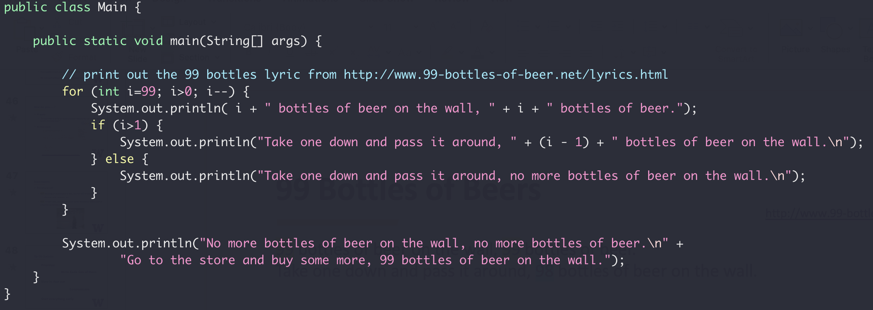
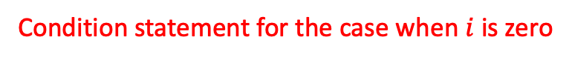
99 Bottles of Beers
Loop to make variable $i$ to change from 99 until $i≤0$
Condition statement for the case when $i$ is zero

Slide 63
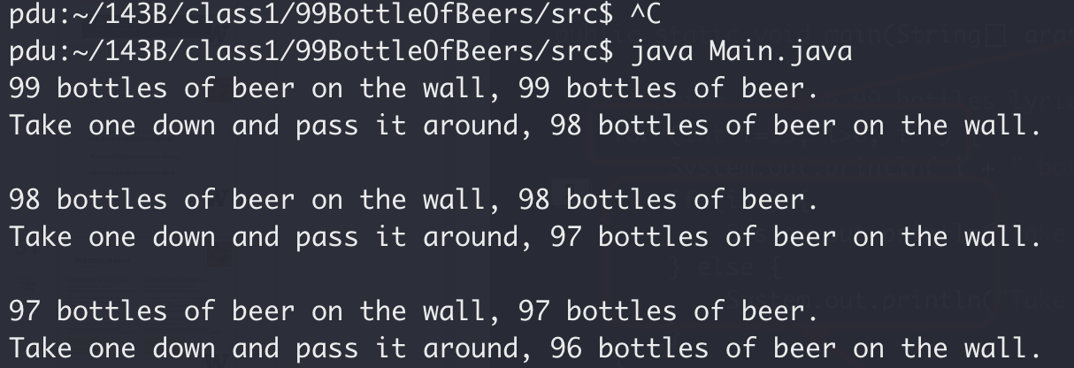
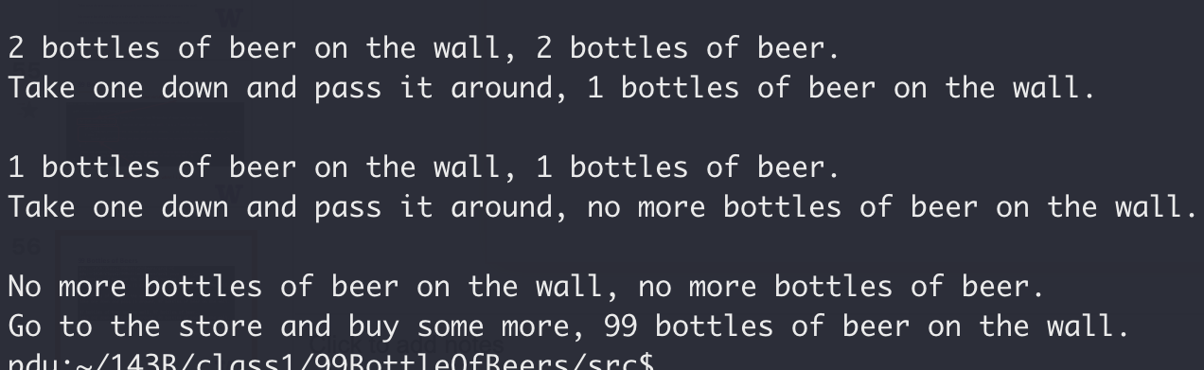
99 Bottles of Beers

Slide 64
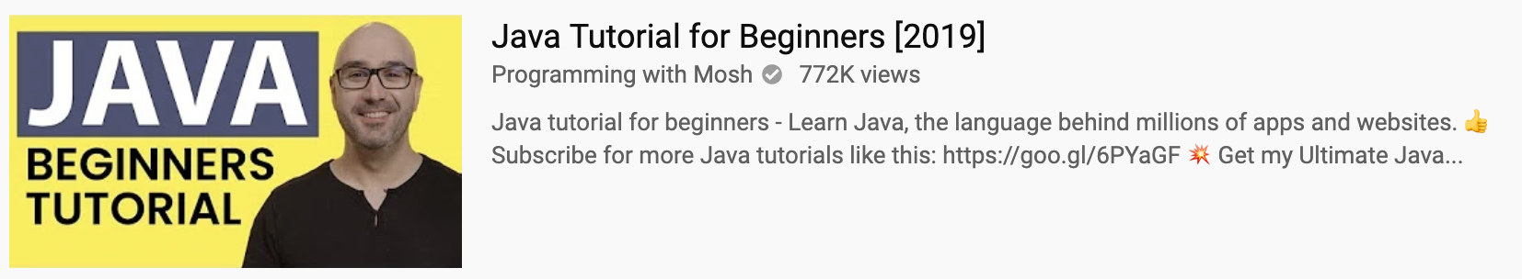
Reading Assignment
Textbook
1.1, 1.2, 1.3
2.1
3.1, 3.2, 3.3
Video:

Slide 65
New things to remember
http://wiki.c2.com/?MakeItWorkMakeItRightMakeItFast

Slide 66
Exercise:
Write a function to find the maximum number in an integer array
Write a function to swap two integers
A bit tricky with passing parameters
12
12
1
7
18
10
3
0
1
2
3
4
5
6

